Slide 1


START. DEV. CHANGE.
Build a Website the Easy Way with Azure Static Web Apps
October 14 & 15, 2020
#startdevchange
Jen Looper
Cloud Developer Advocate Lead
Microsoft
@jenlooper

Slide 2
What are Azure Static Web Apps?
Let’s Explore
A new service from Microsoft
A slick new way to build, deploy, and host your modern web apps
A clean way to manage your app and its API
A nice ecosystem
Let's explore!

Slide 3

I'm a JavaScript developer
What are my options for quickly deploying my web site on Azure? What if the web site also comes with an API?
App Services? Azure Functions? Azure Static Web Apps!

Slide 4
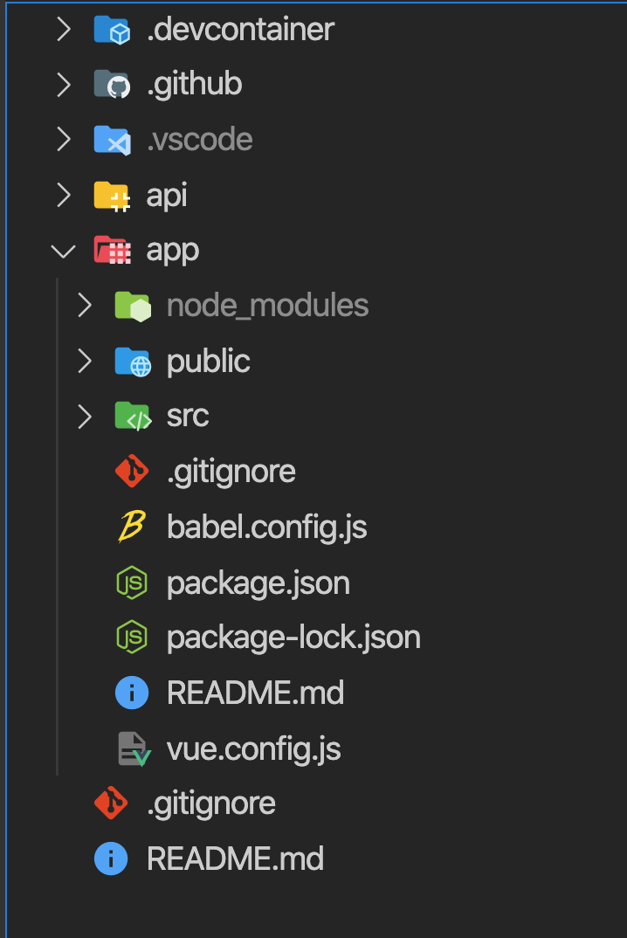
Your architecture: front end
Add your files to '/app'

Slide 5
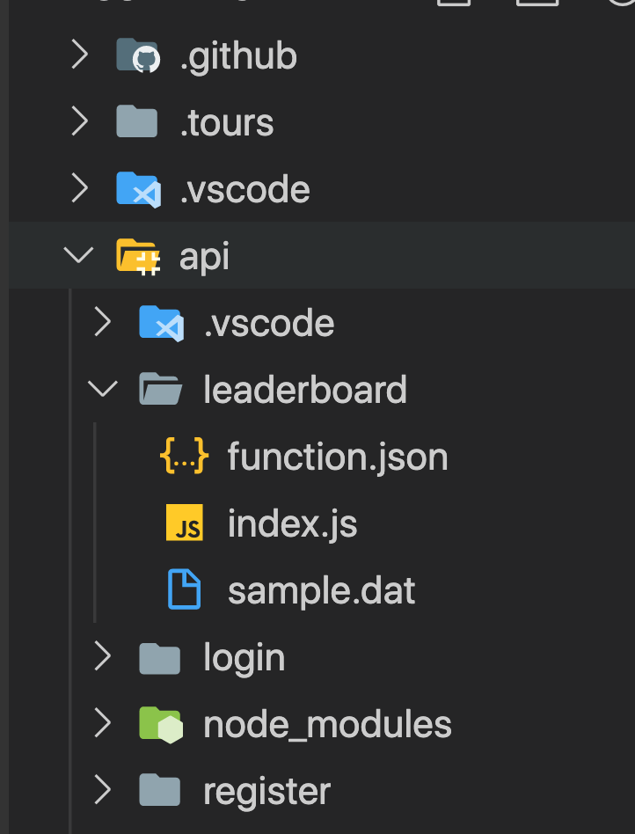
Your architecture: back end
Add your files to '/api

Slide 6
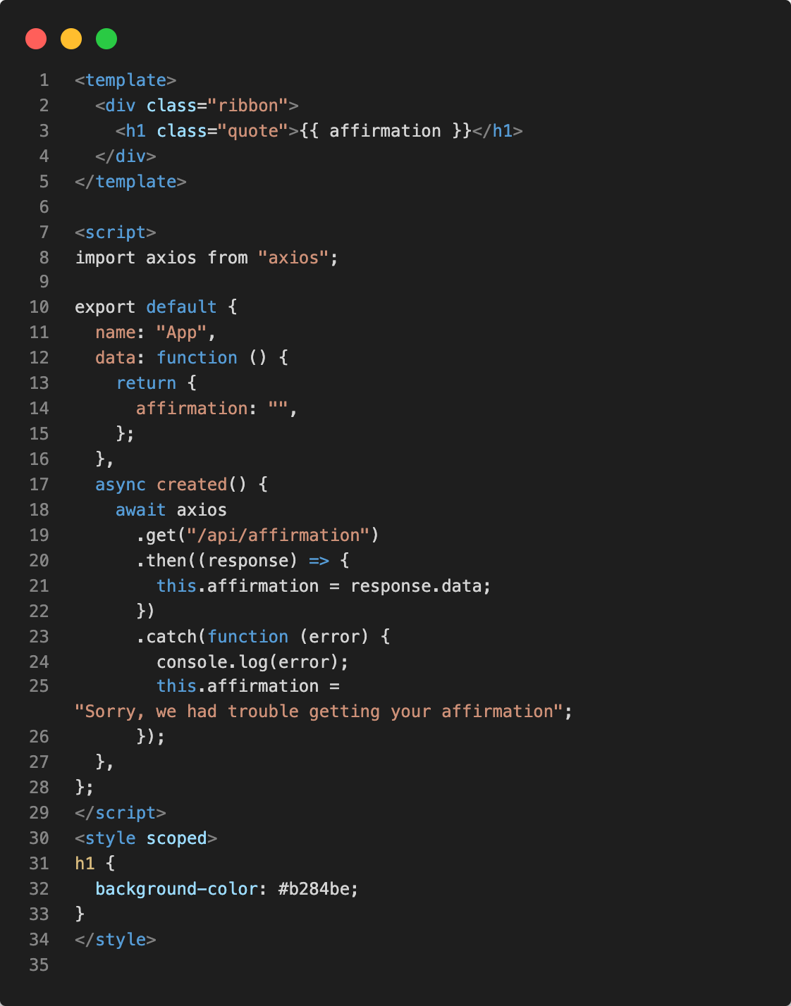
Build up the front end
This will be an app to give an affirmation. Use Visual Studio Code IDE to leverage its extensions for Azure

Slide 7
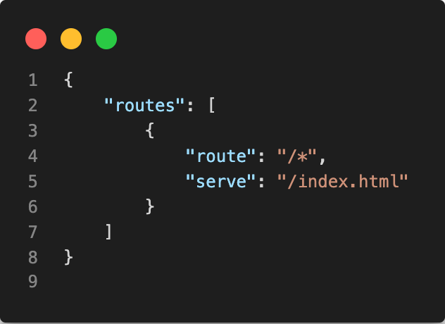
Enable routes
Static web apps need special handling for their routes, so add a routes.json file for the service to route properly

Slide 8
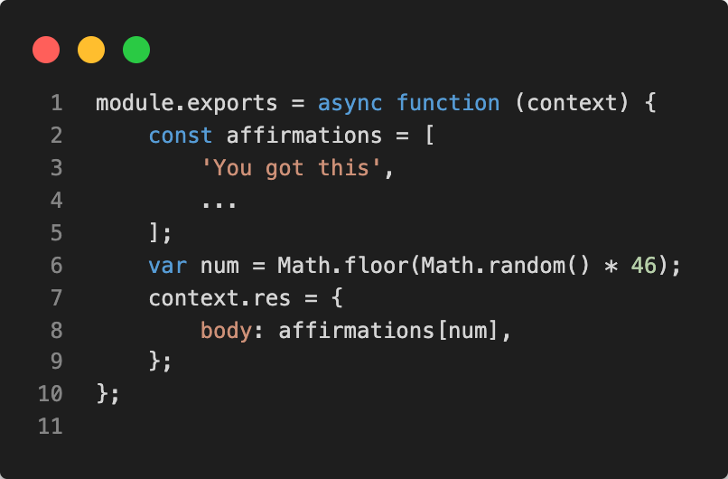
Build up the back end
Use the structure of Azure Functions within your API folder

Slide 9
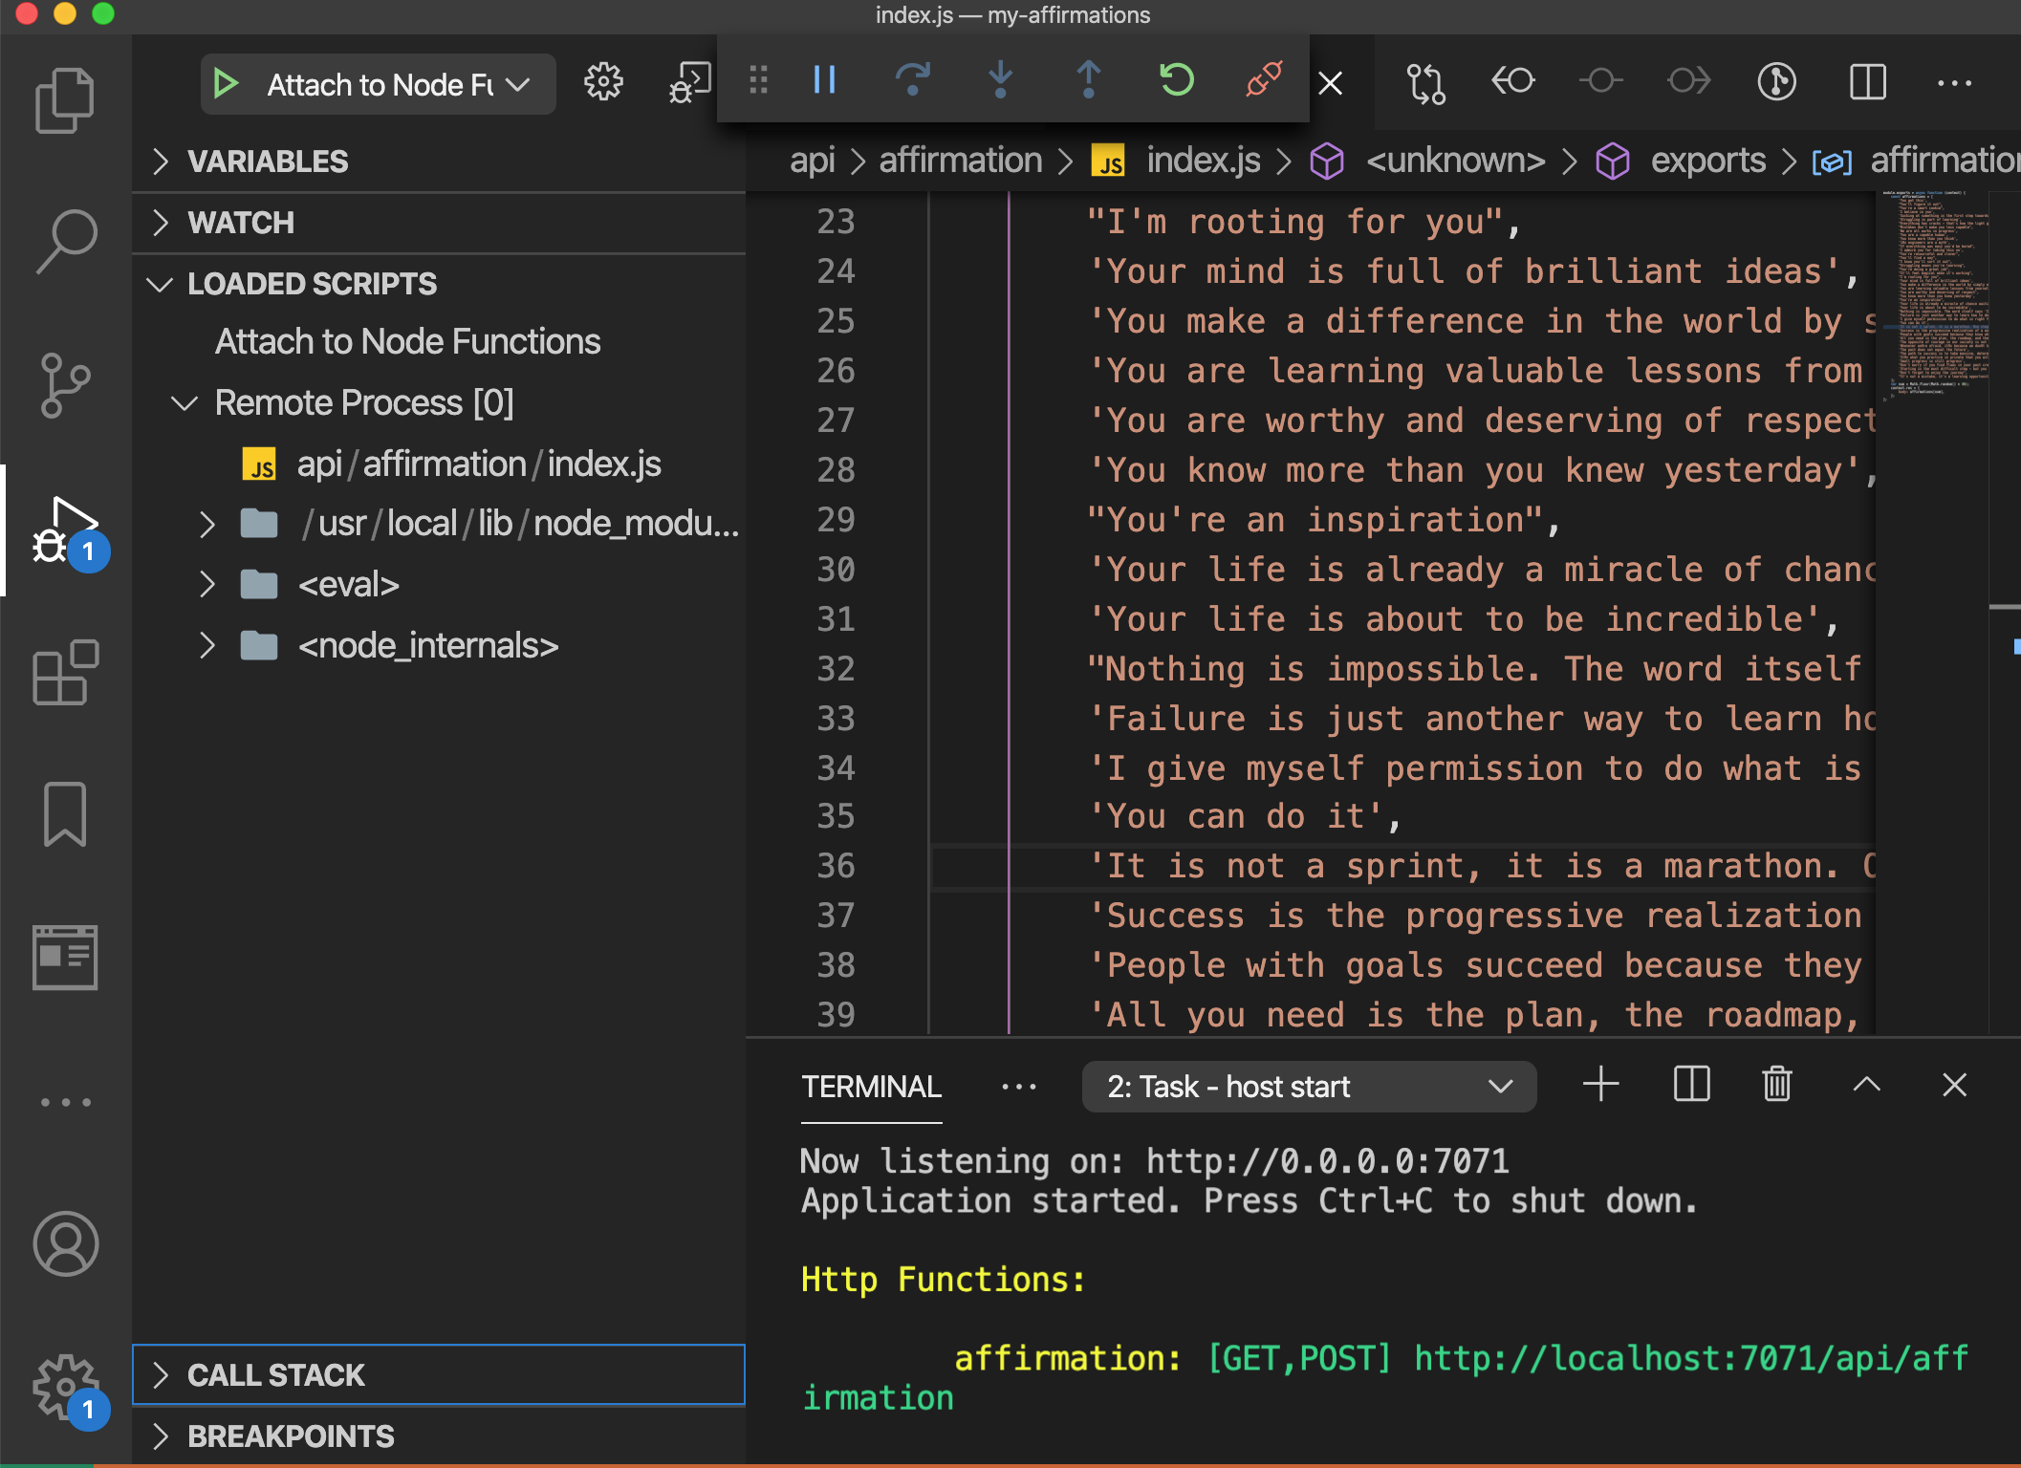
Run your functions locally using the Node debugger from the VS Code terminal
Use the structure of Azure Functions within your API folder
Run on localhost

Slide 10
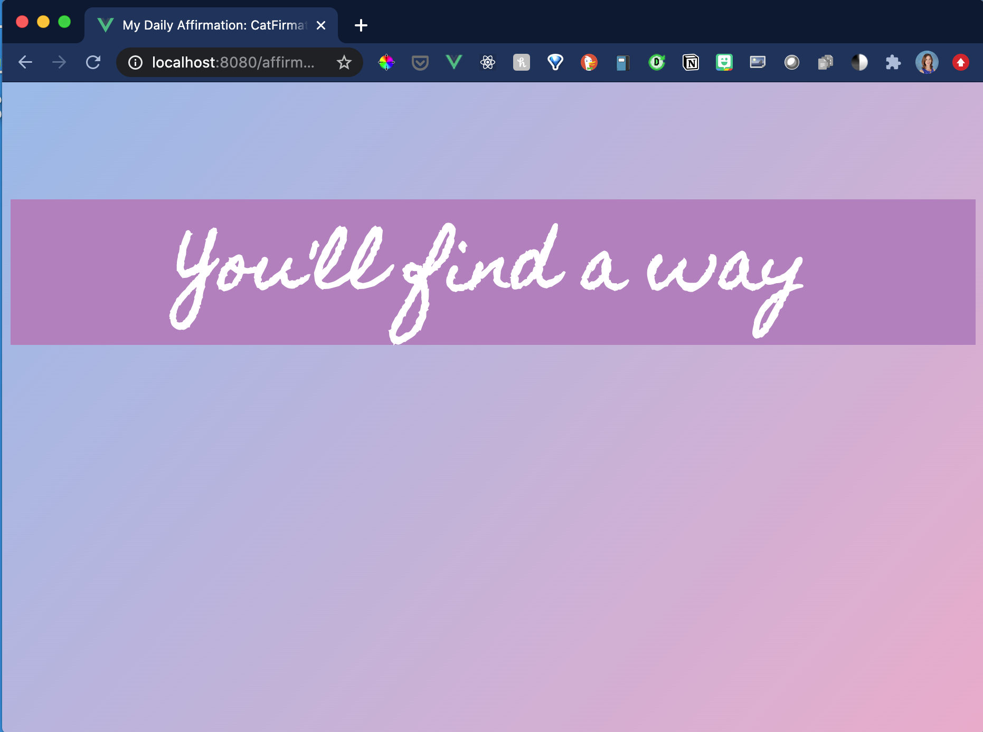
Run the front end on localhost to test your app
Open a new terminal and use your app's CLI to run `npm run serve`

Slide 11
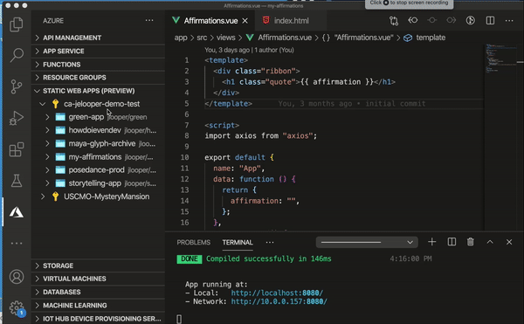
Deploy time!
Push to GitHub, then use the Azure Static Web App VS Code extension to create a new static web app on Azure

Slide 12
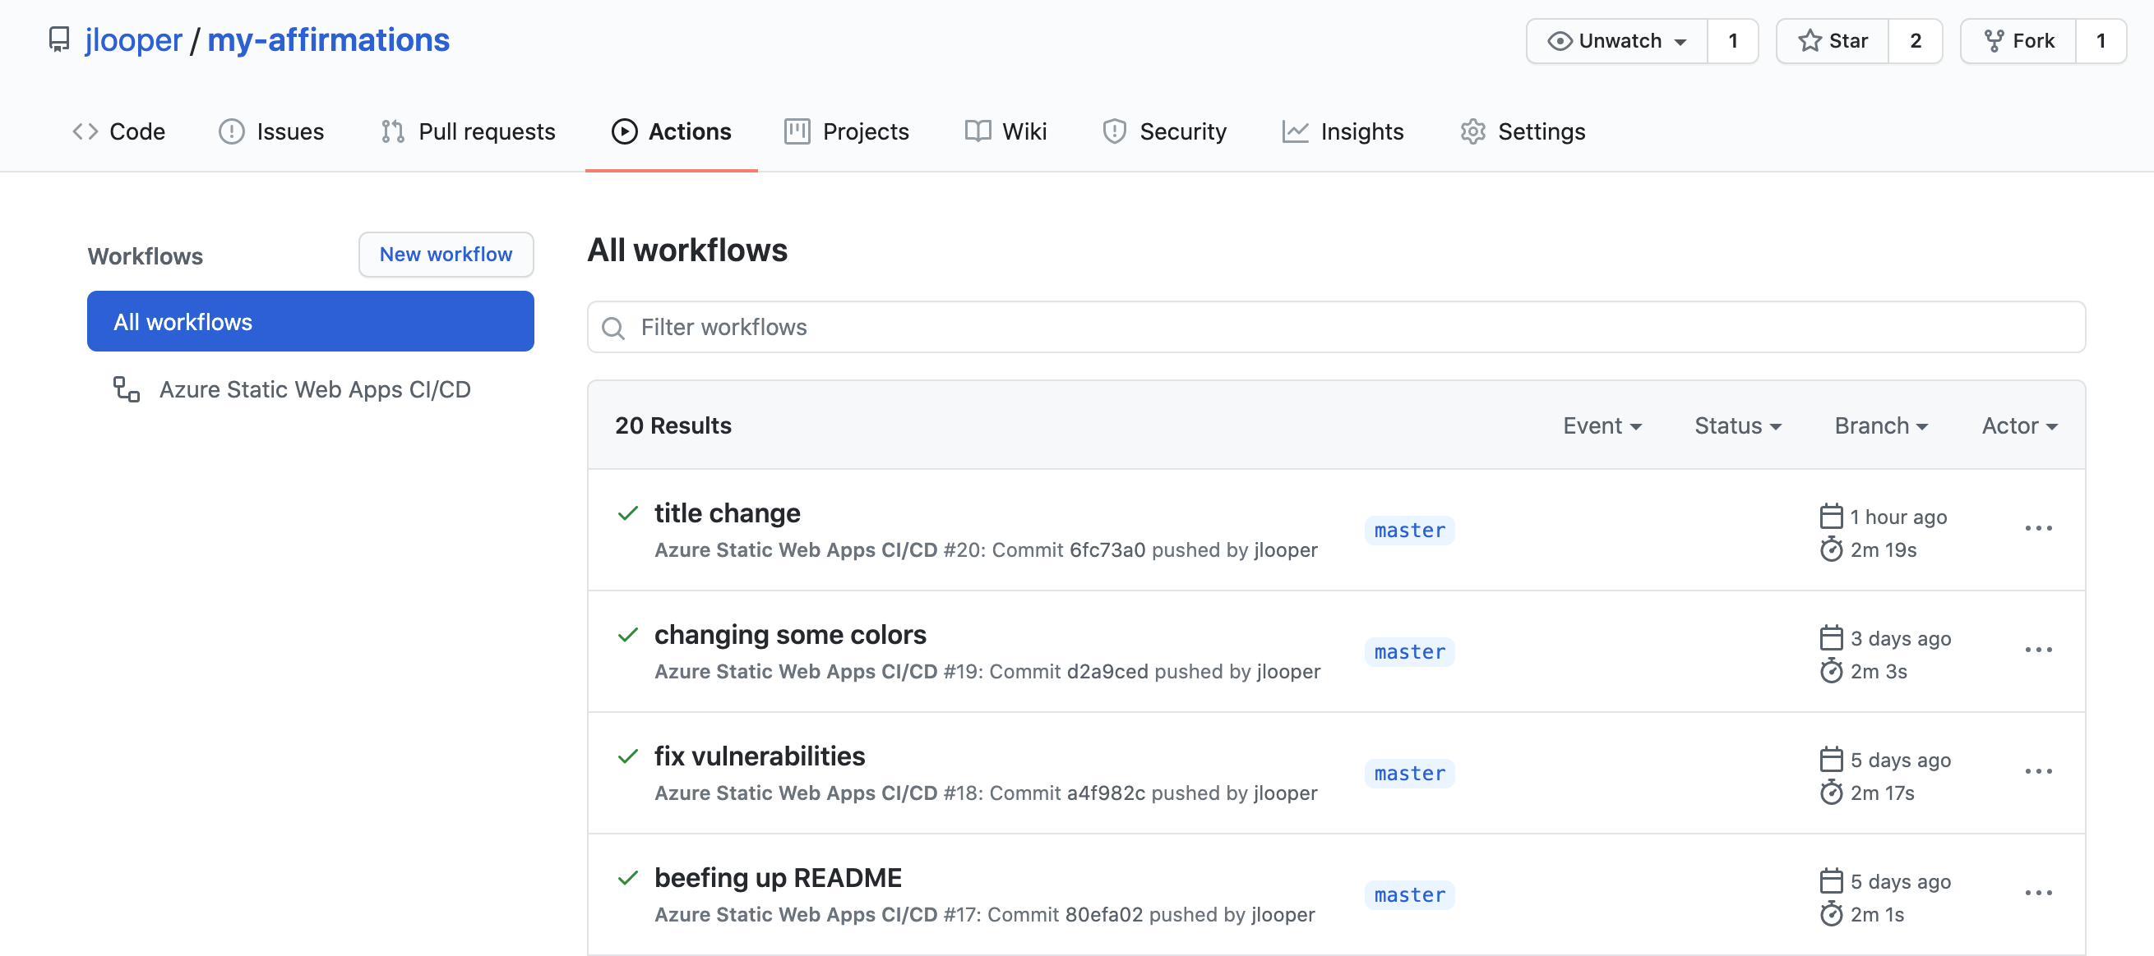
Why GitHub?
GitHub is where the build process is managed, via GitHub Actions!

Slide 13
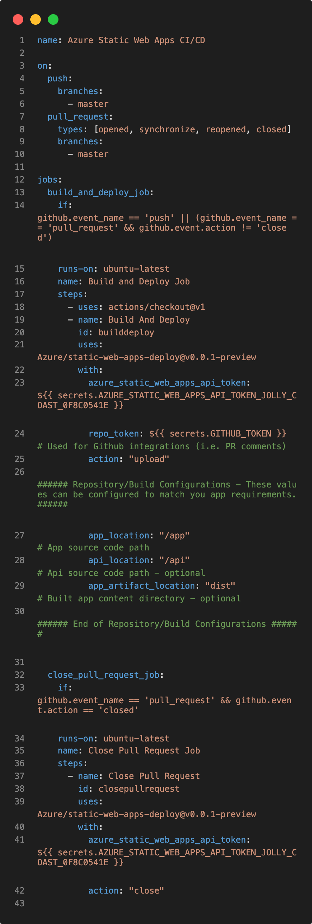
A GitHub Actions file is scaffolded for you
GitHub is where the build process is managed, via GitHub Actions!
When you push to GitHub, your app + API are rebuilt – CI/CD
Try the app: https://aka.ms/my-affirmations

Slide 14
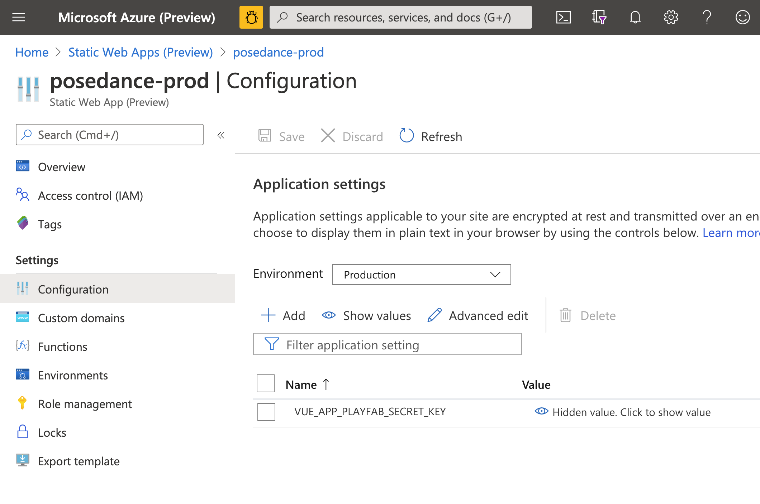
But wait, there's more!
Store tokens!

Slide 15
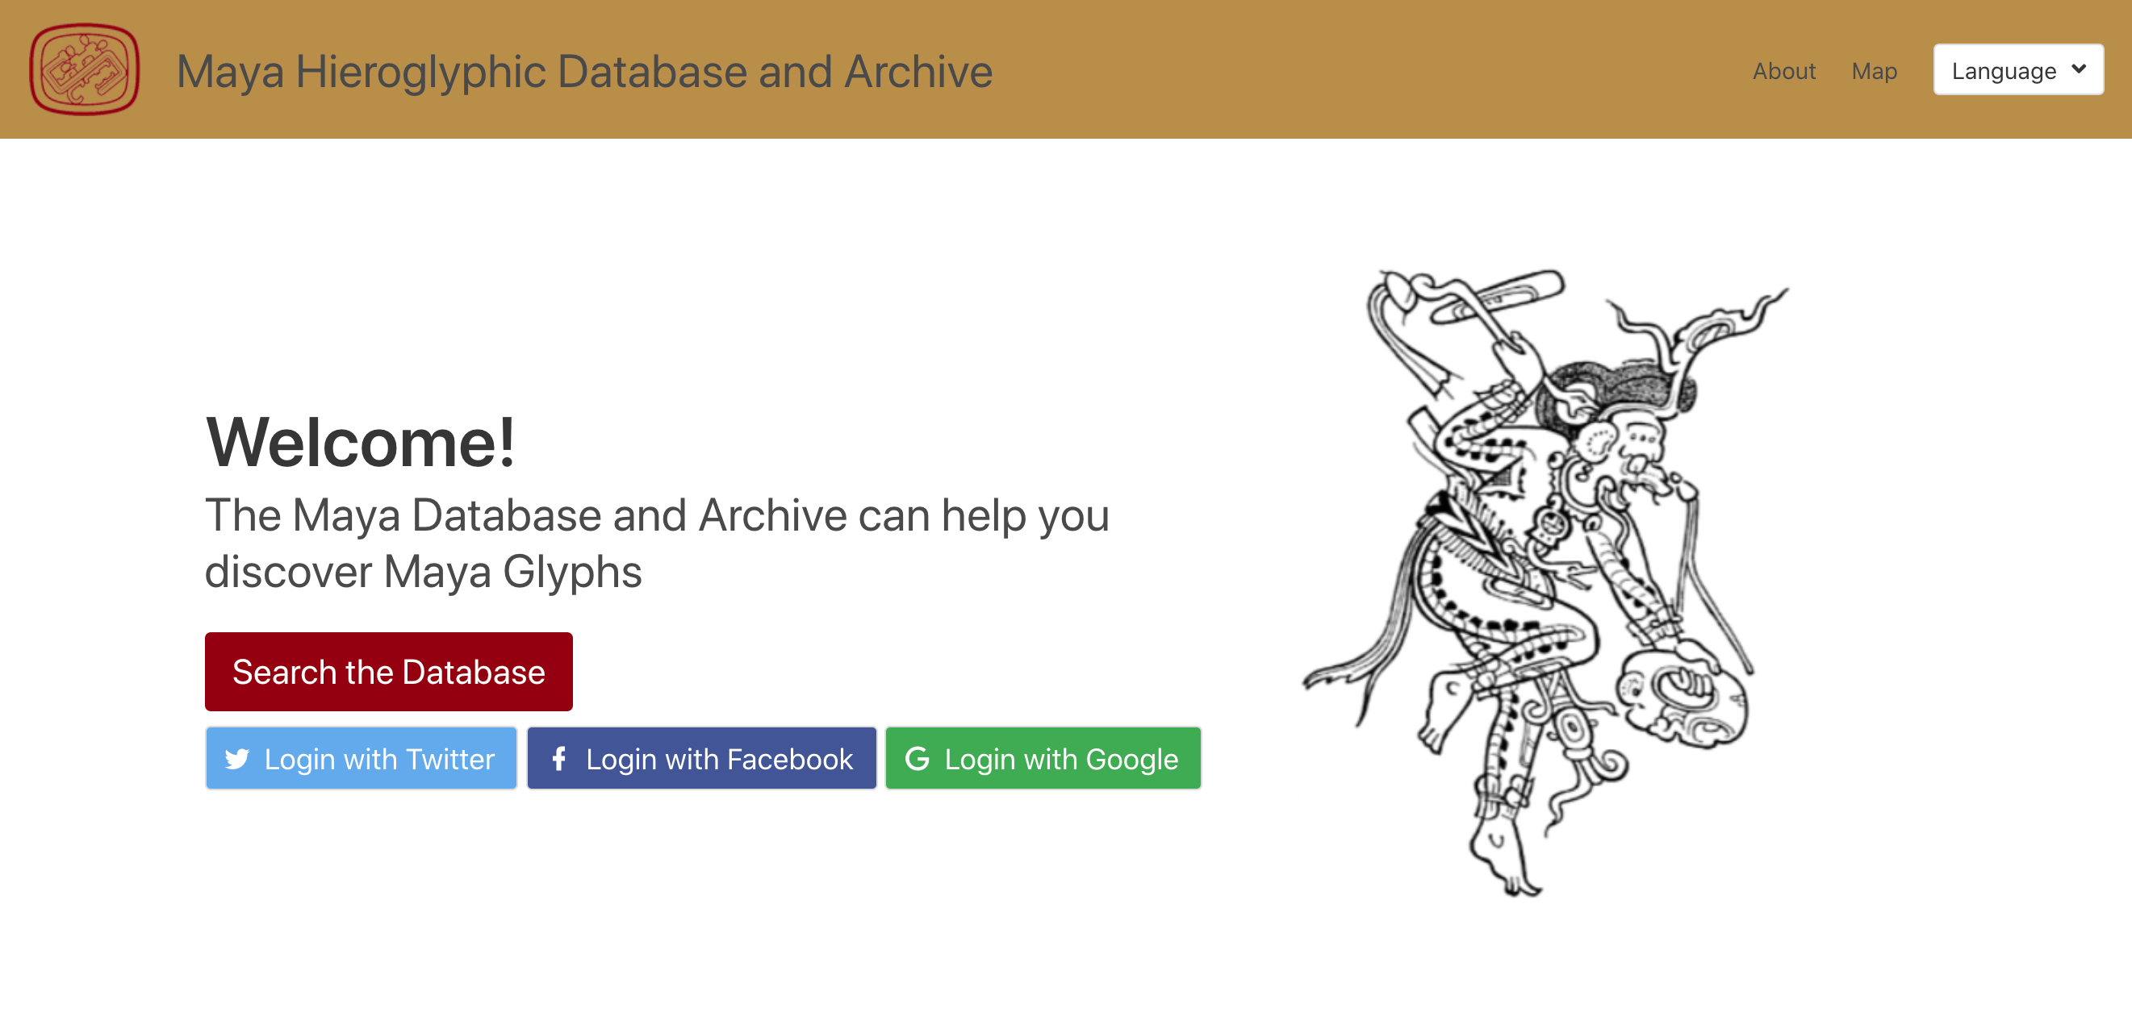
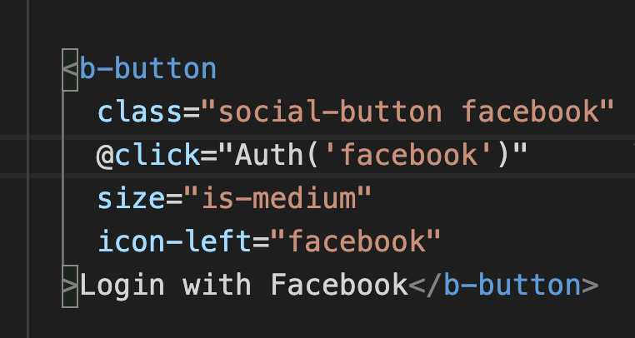
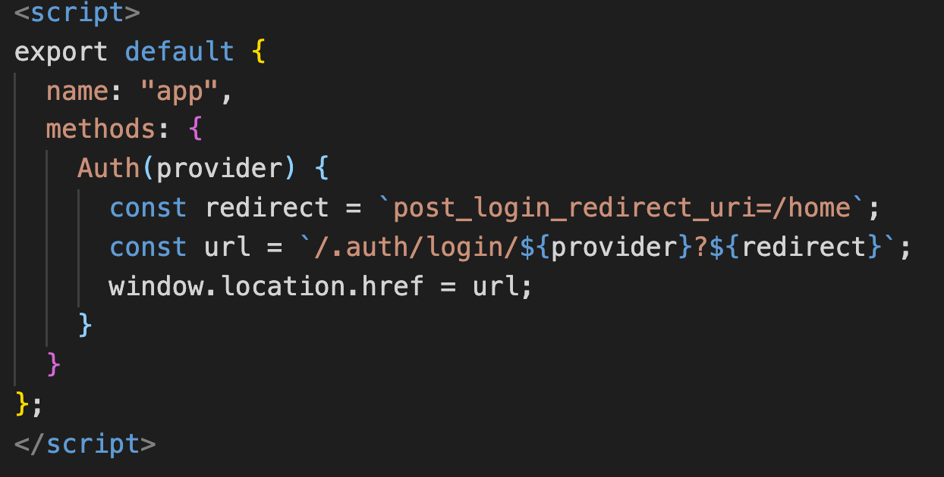
But wait, there's more!
Authenticate users!

Slide 16
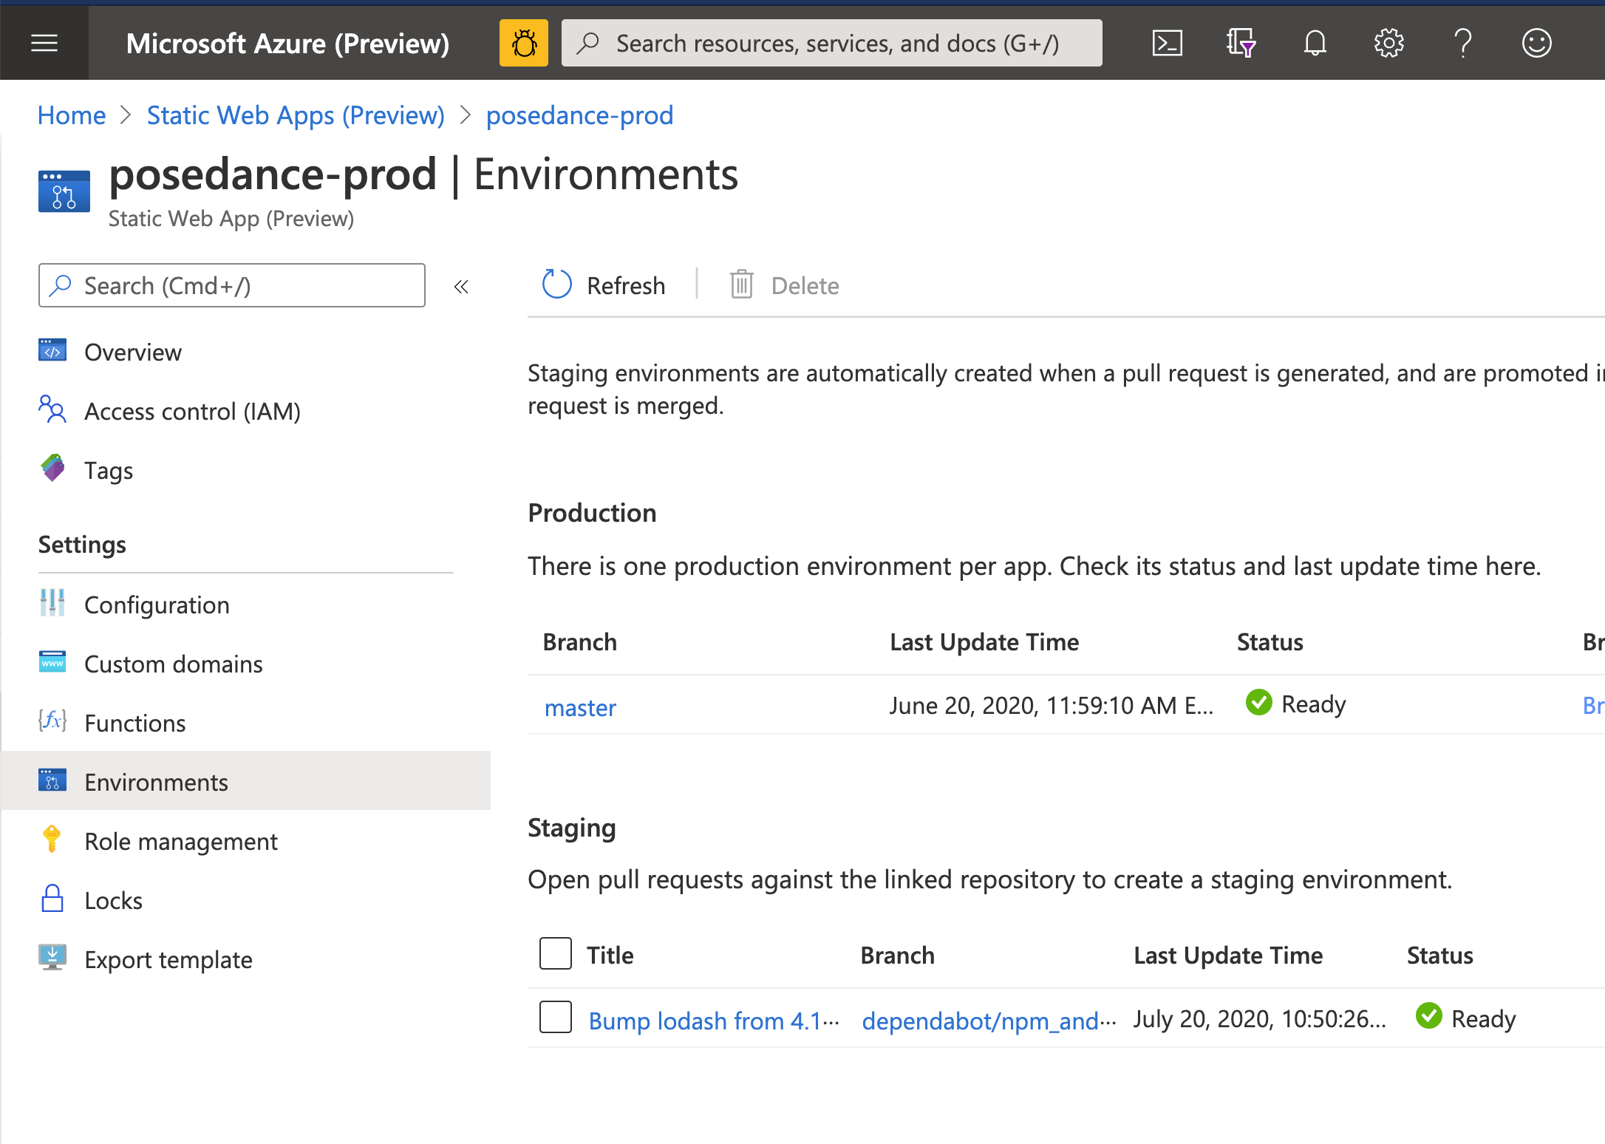
But wait, there's more!
Environment management: scaffold a staging site on push to GitHub

Slide 17
Demo!

Slide 18
Bottom line...
Azure Static Web Apps are a web developer’s dream come true: easy, free deployments, GitHub integration, and it works great with modern JavaScript stack.
* New! You can also write your API with Blazor Web Assembly and .NET functions!
Learn more!
https://aka.ms/swaframeworks

Slide 19

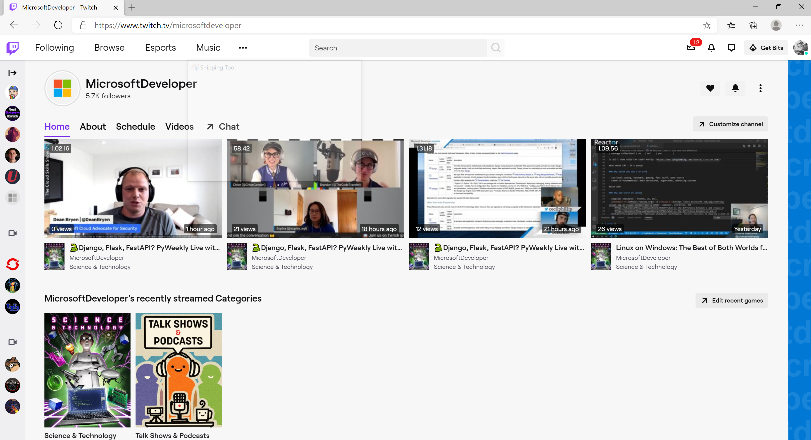
Hang out with us and ask questions live as you learn from Microsoft Developers on a variety of tech concepts!
Visit twitch.tv/MicrosoftDeveloper

Slide 20
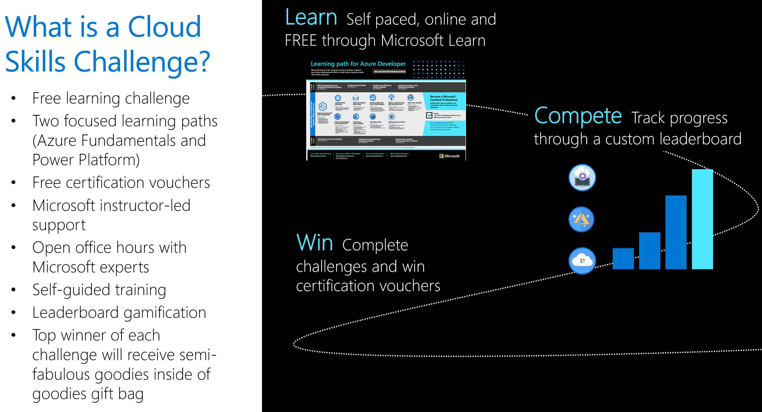
Free Certifications with the Cloud Skills Challenge!
Join the cloud skills challenge and complete to receive a free Microsoft certification!
Microsoft experts will be here to support you and answer your questions via livestreamed instructor-led content and open office hours!
Livestream on Twitch for Azure Fundamentals on October 20, 11am PDT.
Livestream on Twitch for Power Platform Fundamentals on October 27, 11am PDT.
To sign up visit aka.ms/startdevchange

Slide 21
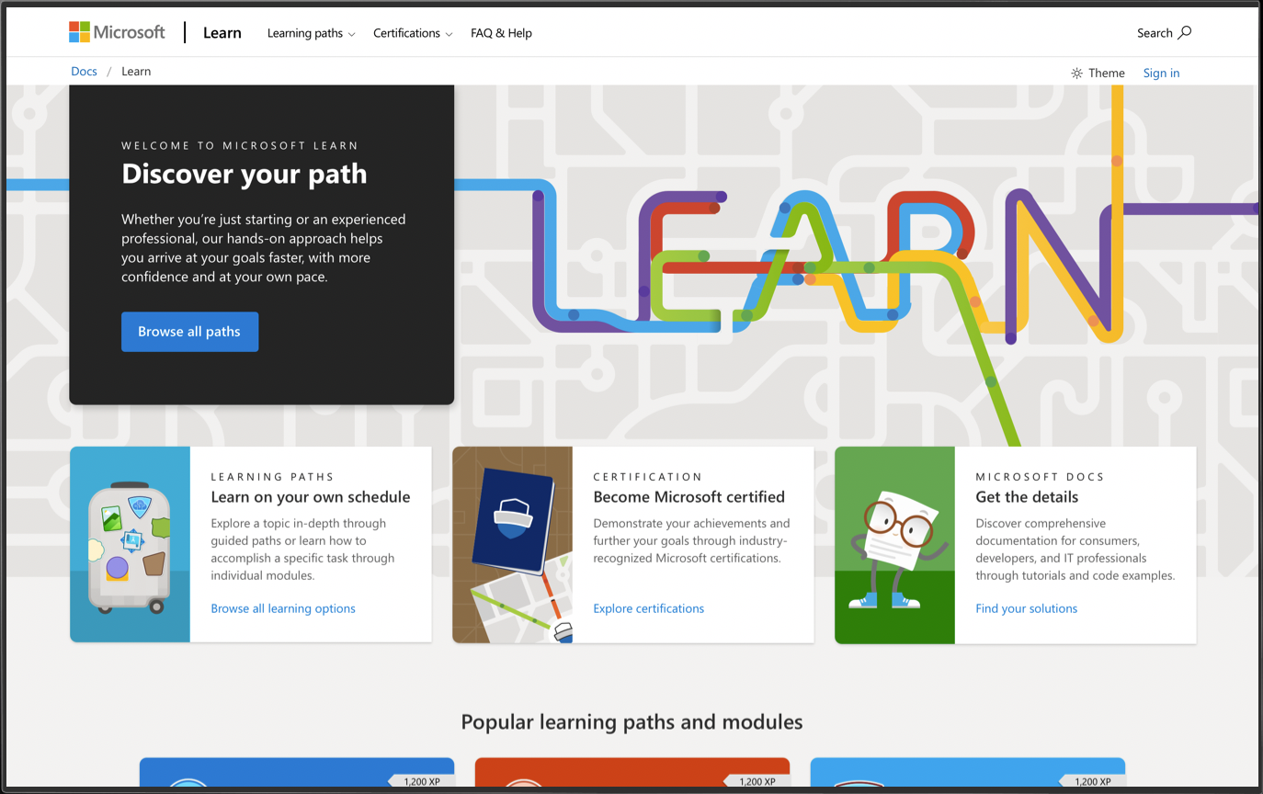
/MS Learn alert
Complete interactive learning exercises, watch videos, and practice and apply your new skills.
aka.ms/sdc/staticwebapps

